Slide 1

Employee Performance Analysis
Employee Performance Data
CIS 3252.03
Business Intelligence
KenJorren Culata

Slide 2
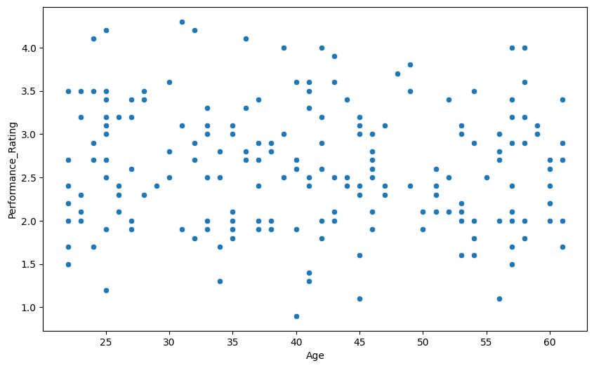
Age vs. Performance Ratings
Analytical Correlation:
Are older employees more likely to have higher Performance Ratings?
Statistic
Calculating the correlation between Age and Performance Rating columns = -0.0684 correlation
1 indicates a positive correlation
-1 indicates negative correlation
0 indicates no linear correlation
Visualization
As illustrated in the scatter plot, there is no indication that Age correlates with given performance ratings.
Summary & Insights
Given that age doesn’t impact performance, emphasis on skills, accomplishments, and contribution determines promotions opportunities, and rewards.
Equal opportunity between age groups can bring dependable perspectives and innovative solutions.
This raises the question: What other factors might influence employee performance ratings if age has no significant impact?

Slide 3
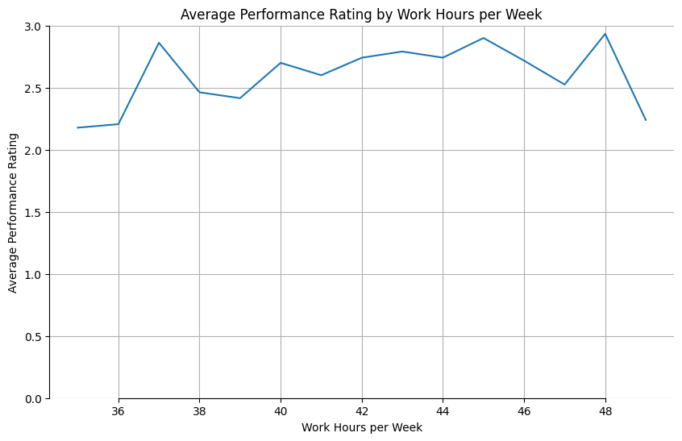
Hours vs. Performance Ratings
Analytical Question:
Are longer work hours associated with higher performance ratings for employees?
Statistic
Visualization
As illustrated in the line graph, there is an increase in average performance towards the center of Work Hours per week.
Summary & Insights
The average rating in performance related to work hours per week shows a slight bell curve.
Working at the lowest and highest hours per week shows a noticeable decrease in performance.
This raises the question: What is the optimal range of work hours per week that results in the highest average performance rating?

Slide 4
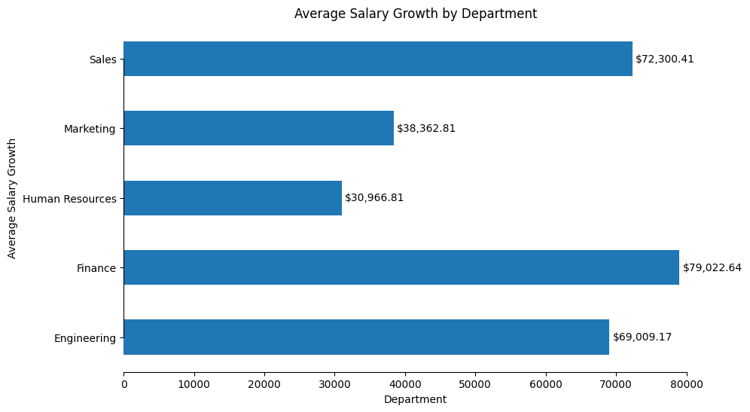
Years of Experience, Salary vs. Departments
Analytical Question
What’s the average Salary growth with Years of Experience across departments?
Statistic
Salary / Years of Experience
= Salary Growth
Visualization
As illustrated in the horizontal bar graph, the average salary growth is highest in the Finance Department.
Summary & Insights
Experienced employees in the Finance department are compensated for their knowledge
Ensure that experienced employees provide mentoring to newer employees to share knowledge and promote organizational growth
This raises the question: What factors within the Finance department contribute to the highest average salary growth compared to the other departments?

